Slide 1










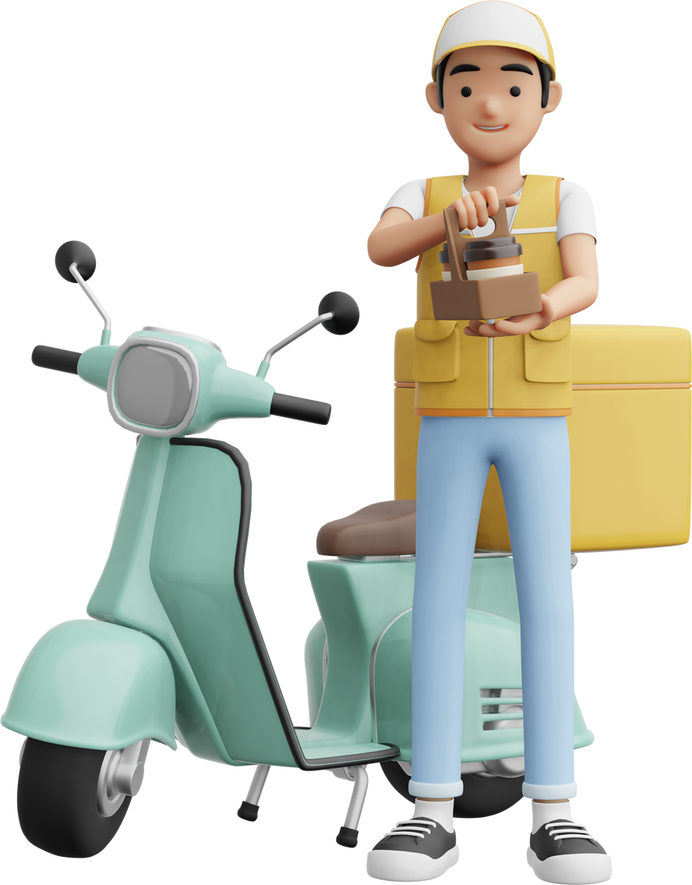


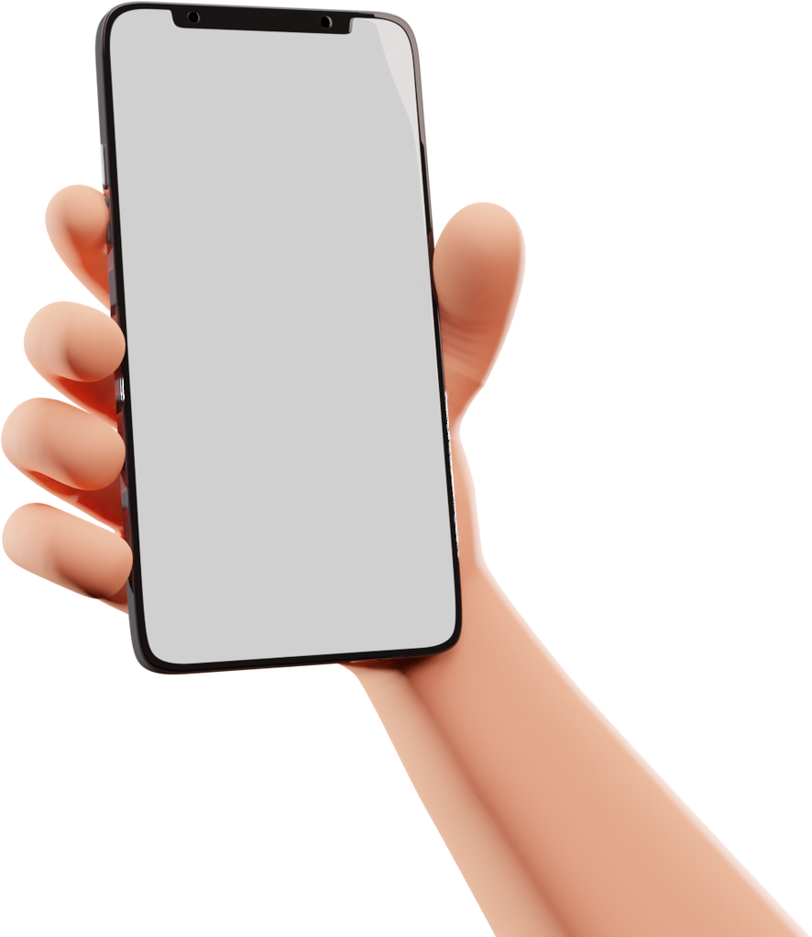







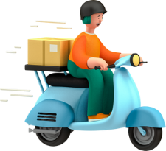



CRETAED BY:
TEAM LEADER
moria GROHAR
323082024
joshua gordon
332307073
shirel Zecharia
211551072
yakov elkobi
305446627
parcelpal
AVAILABLE ON
Order details
ETA: 11: 45
parcelpal
Review
Review
Chat

Slide 2




parcelpal
MEET THE TEAM
TEAM LEADER
Screens:
Login, Registration,
Chats Driver, Chats client
Screens:
Pick driver, Package status, My drives, Edit Profile, Edit delivery, Choosen deliveries, Home screen client, Home screen Driver
moria GROHAR
joshua gordon
Screens:
Add drive, New delivery (add package),
Pick packages
Screens:
Reviews received, Reviews Given
shirel zecharia
yakov
elkobi

Slide 3
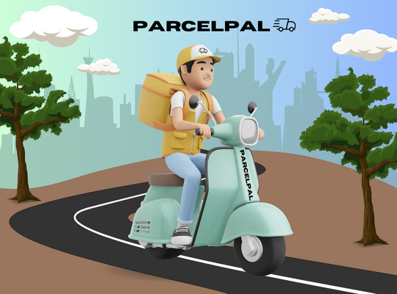
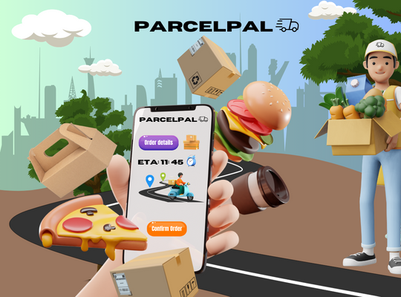
ABOUT
parcelpal
ParcelPal is a cross-platform mobile application designed for both Android and iOS devices. The app addresses the growing demand for efficient and reliable package delivery services.
The app aims to streamline the process of connecting people who seek help delivering a package with drivers willing to deliver the package freely.
ParcelPal offers a practical solution for the increasing demand for efficient , free and reliable package delivery services. ParcelPal fills this gap by providing a user-friendly and efficient platform for package delivery.

Slide 4


ABOUT - SIMILAR APPS
parcelpal
ParcelPal faces competition from other package delivery services, such as Uber Connect and Roadie. These services offer similar features and functionality, allowing clients to post packages and connect with drivers for delivery. However, ParcelPal differentiates itself by focusing on the social value of helping others because the cost of the service is 0$!

Slide 5
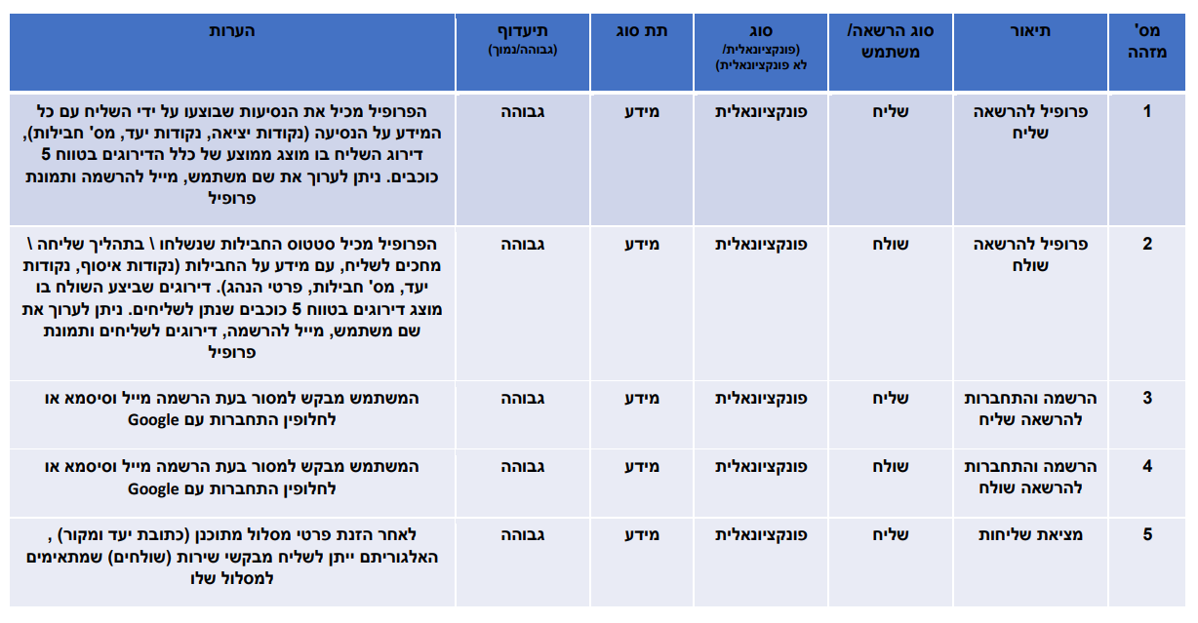
FUNCTONIAL AND NON FUNCTINOAL REQUIRMENTS
MAIN FEATURES

Slide 6
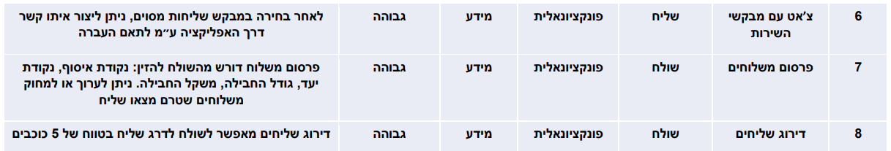
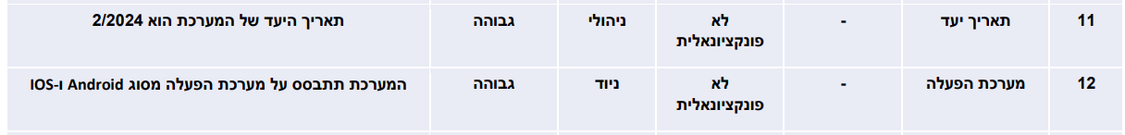
FUNCTONIAL AND NON FUNCTINOAL REQUIRMENTS
MAIN FEATURES

Slide 7
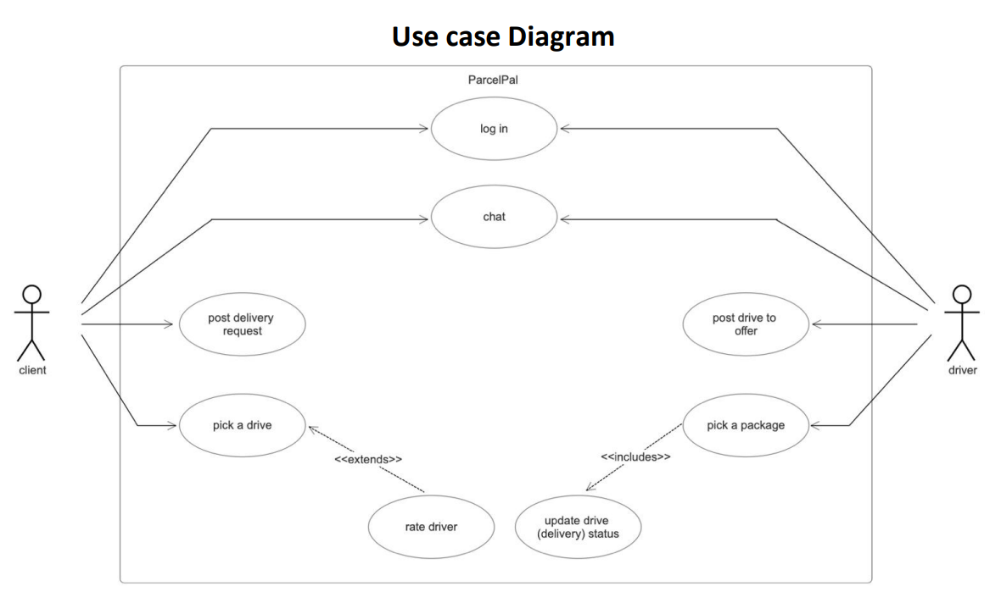
UML’S: USECASE
<<extends>>
Update the package status as delivered

Slide 8
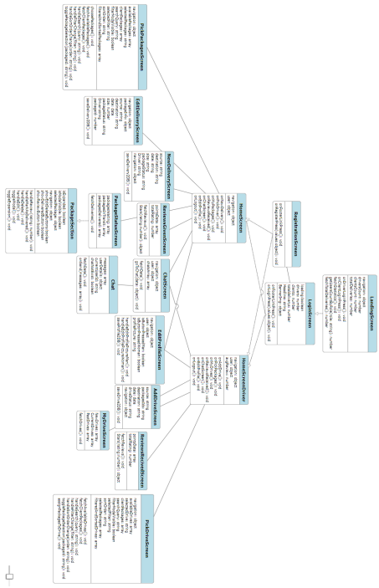
UML’S: FULL CLASS DIAGRAM

Slide 9
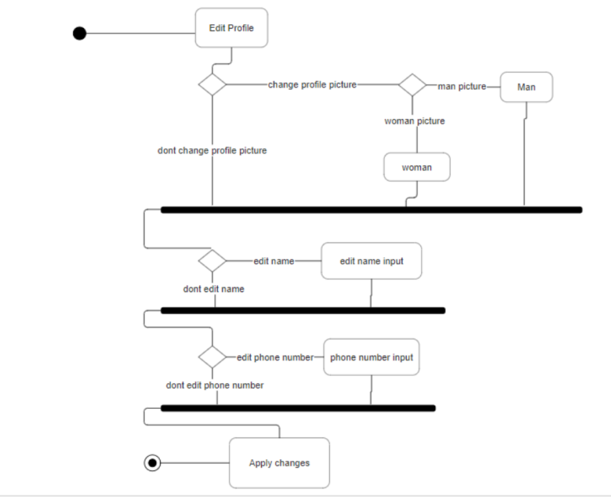
UML’S: ACTIVITY DIAGRAM EDIT PROFILE

Slide 10
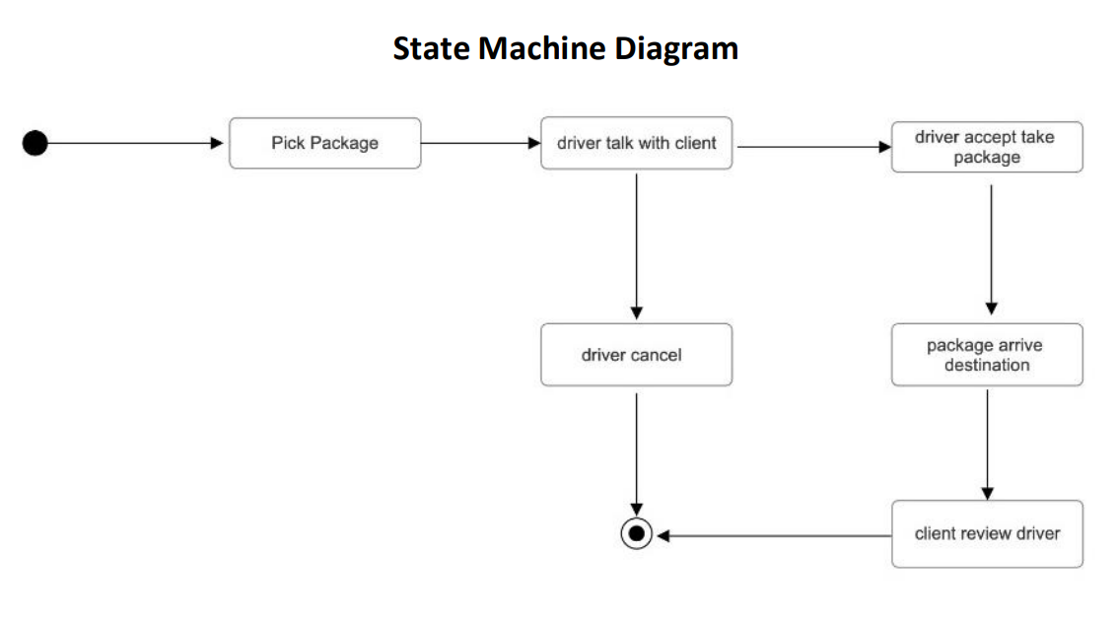
UML’S: STATE MACHINE DIAGRAM

Slide 11


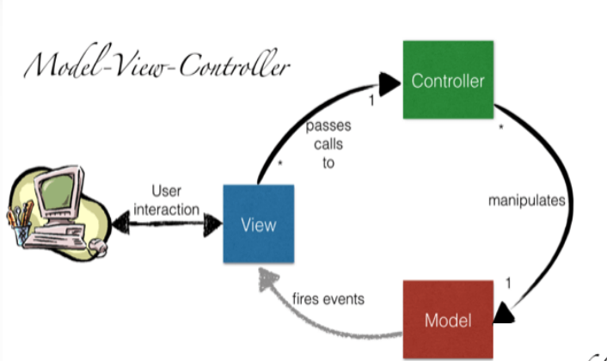
TECH STACK AND DATA BASE
Expo
Notes:
Mvc בreact native זה קצת שונה, אצלנו: m - firebase
v - view (מה שמוצג על המסך)
c - controller

Slide 12

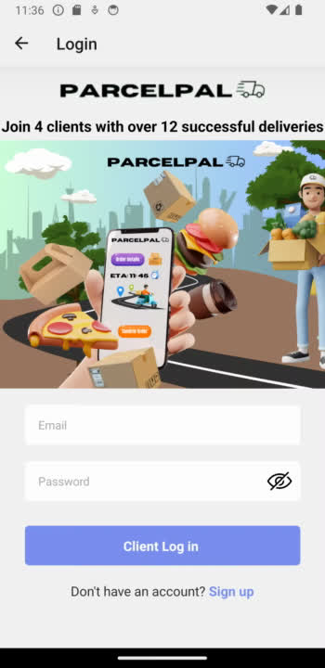
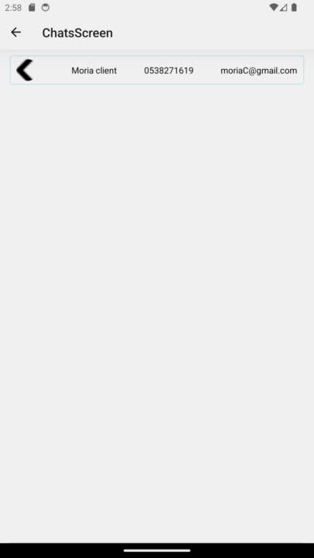
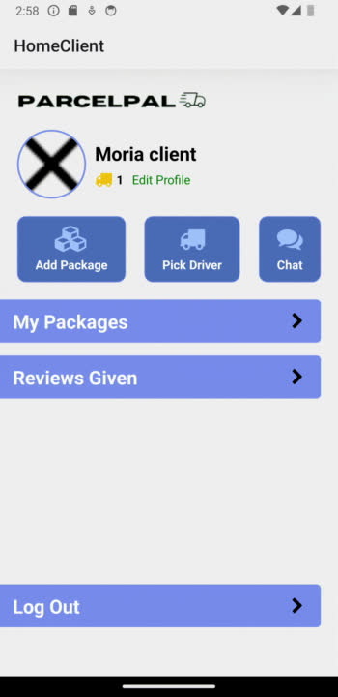
TEAM LEADER
Signup and signin
Driver chat
Client chat
moria GROHAR

Slide 13


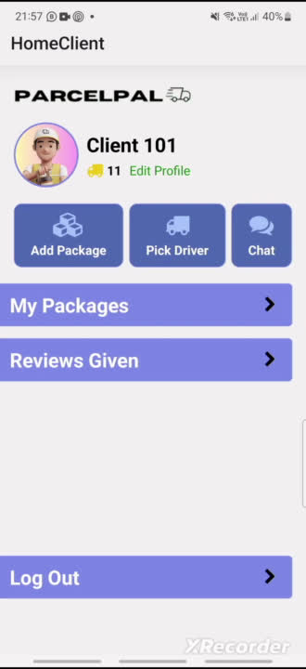
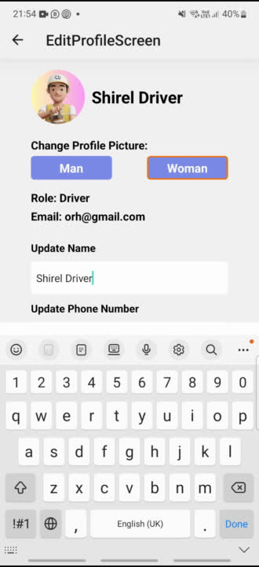
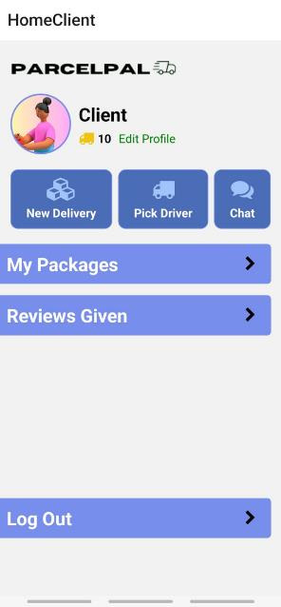
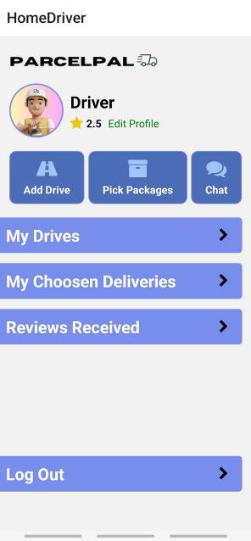
joshua gordon
Pick Driver
Package Status
Choosen deliveries
My Drives
Edit Profile

Slide 14

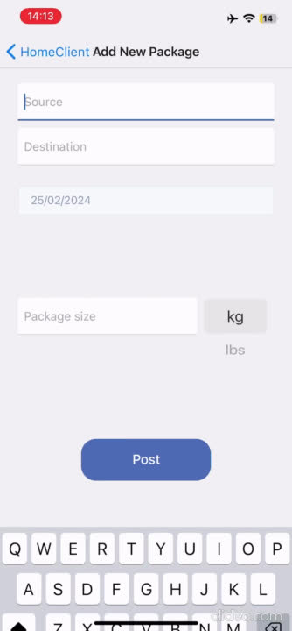
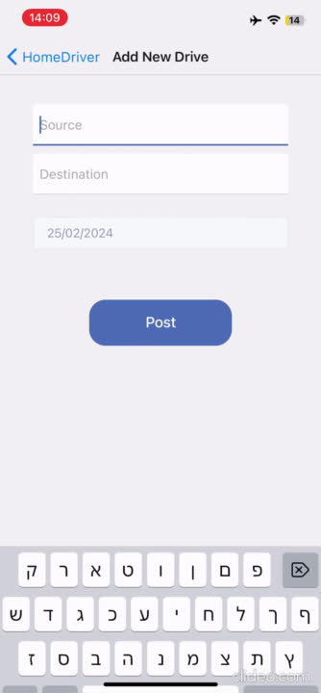
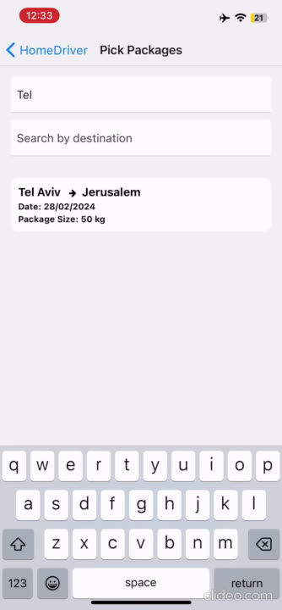
Add New Package
Add New Drive
Pick from available packages
shirel

Slide 15

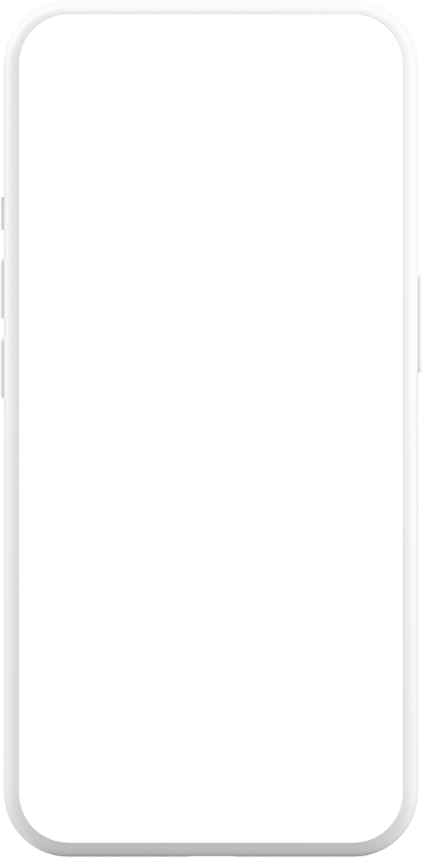
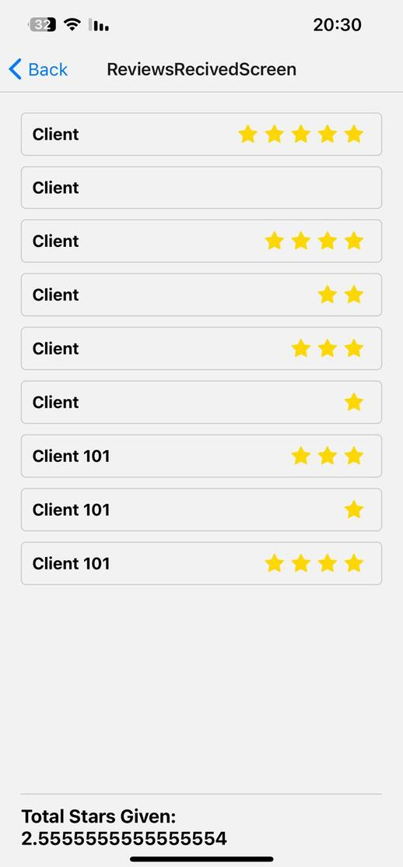
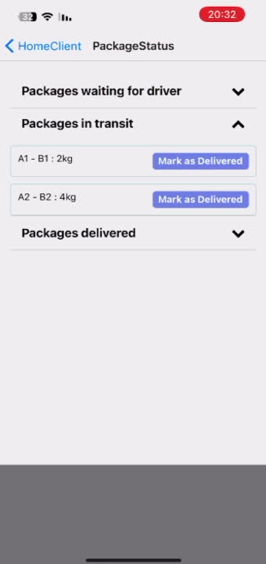
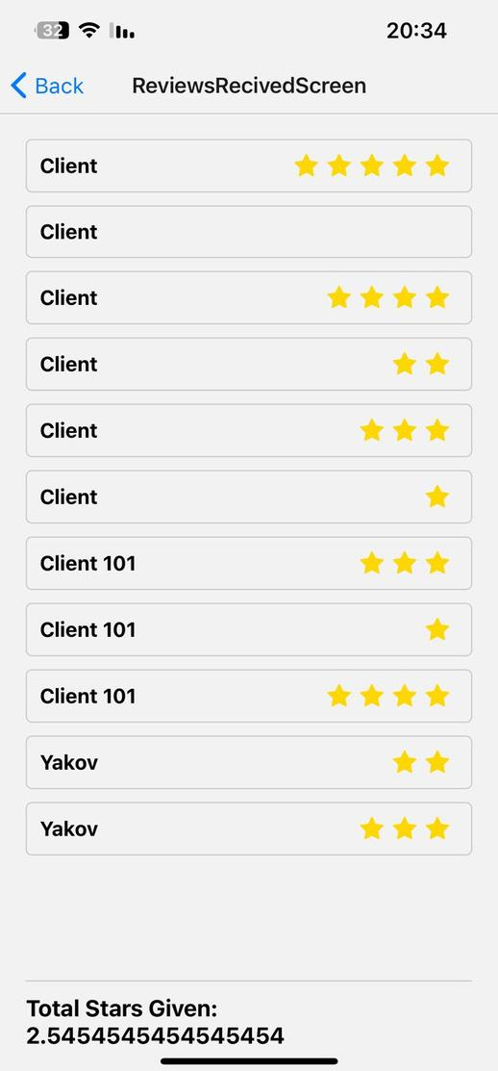
Reviews Recived before
cliient review
Reviews recived after
yakov

Slide 16
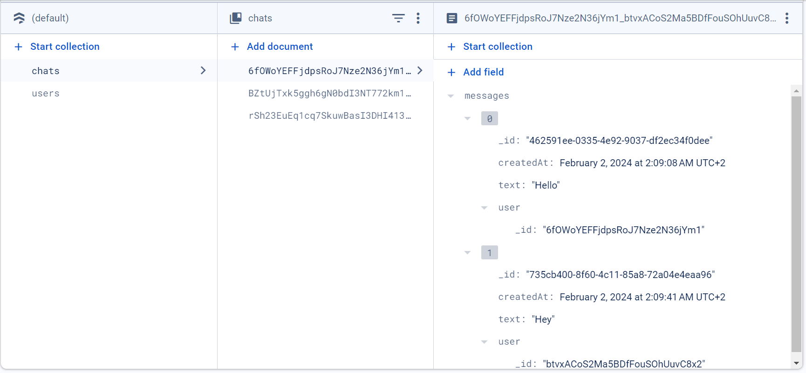
DATABASE - CHATS

Slide 17
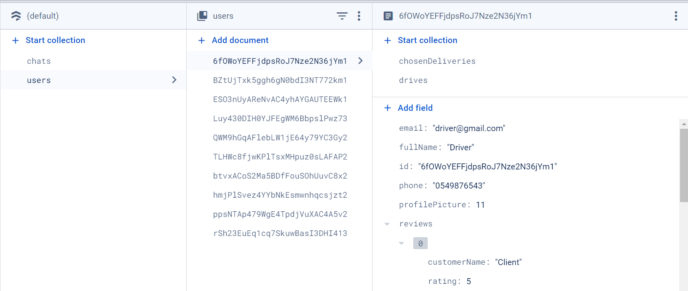
DATABASE - USERS (DRIVER)

Slide 18
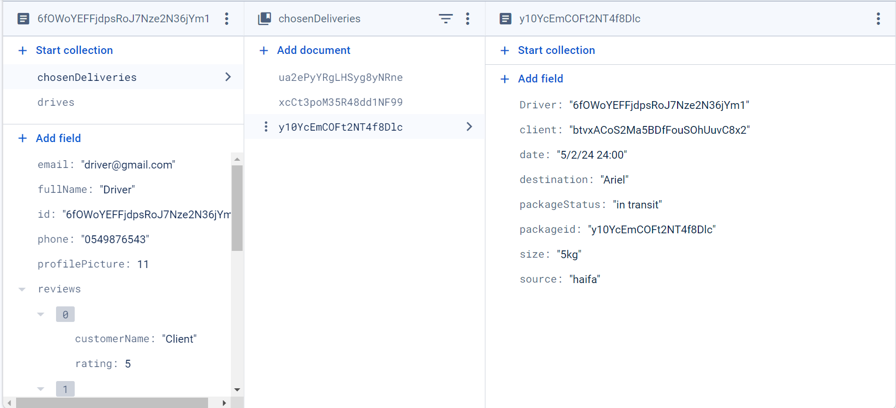
DATABASE - USERS (DRIVER) - CHOSENDELIVERIES

Slide 19
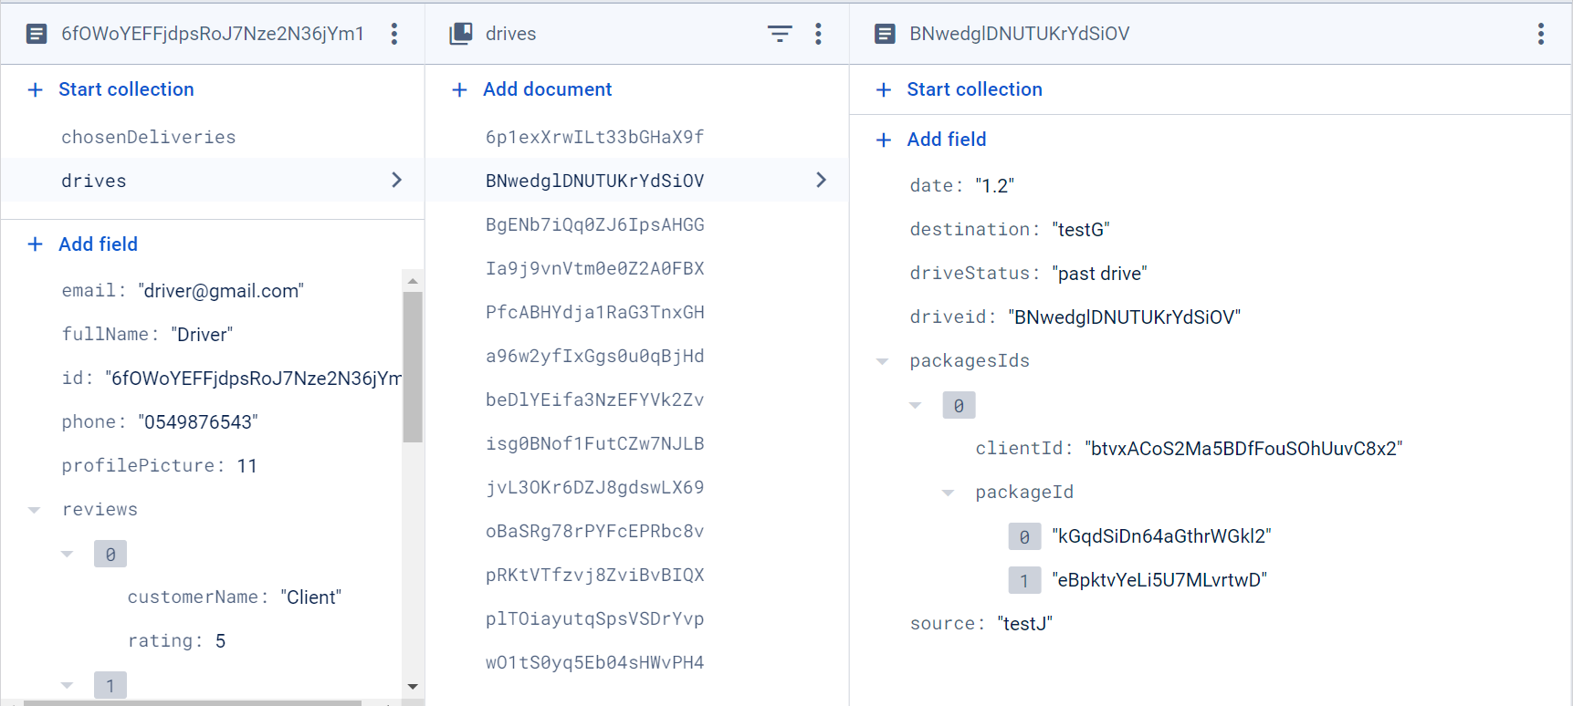
DATABASE - USERS (DRIVER) - DRIVES

Slide 20
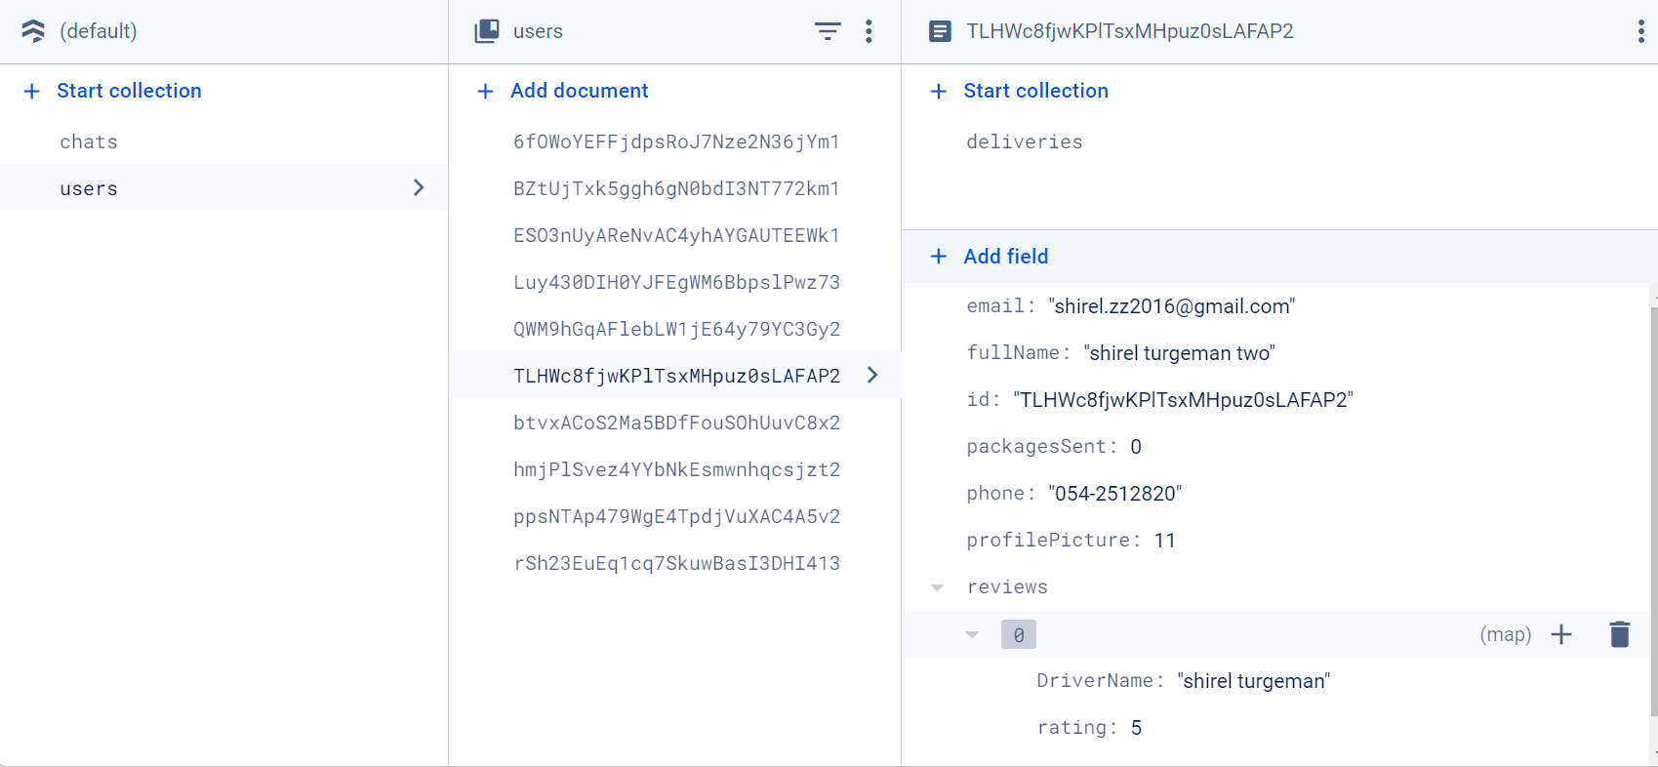
DATABASE - USERS (CLIENT)

Slide 21
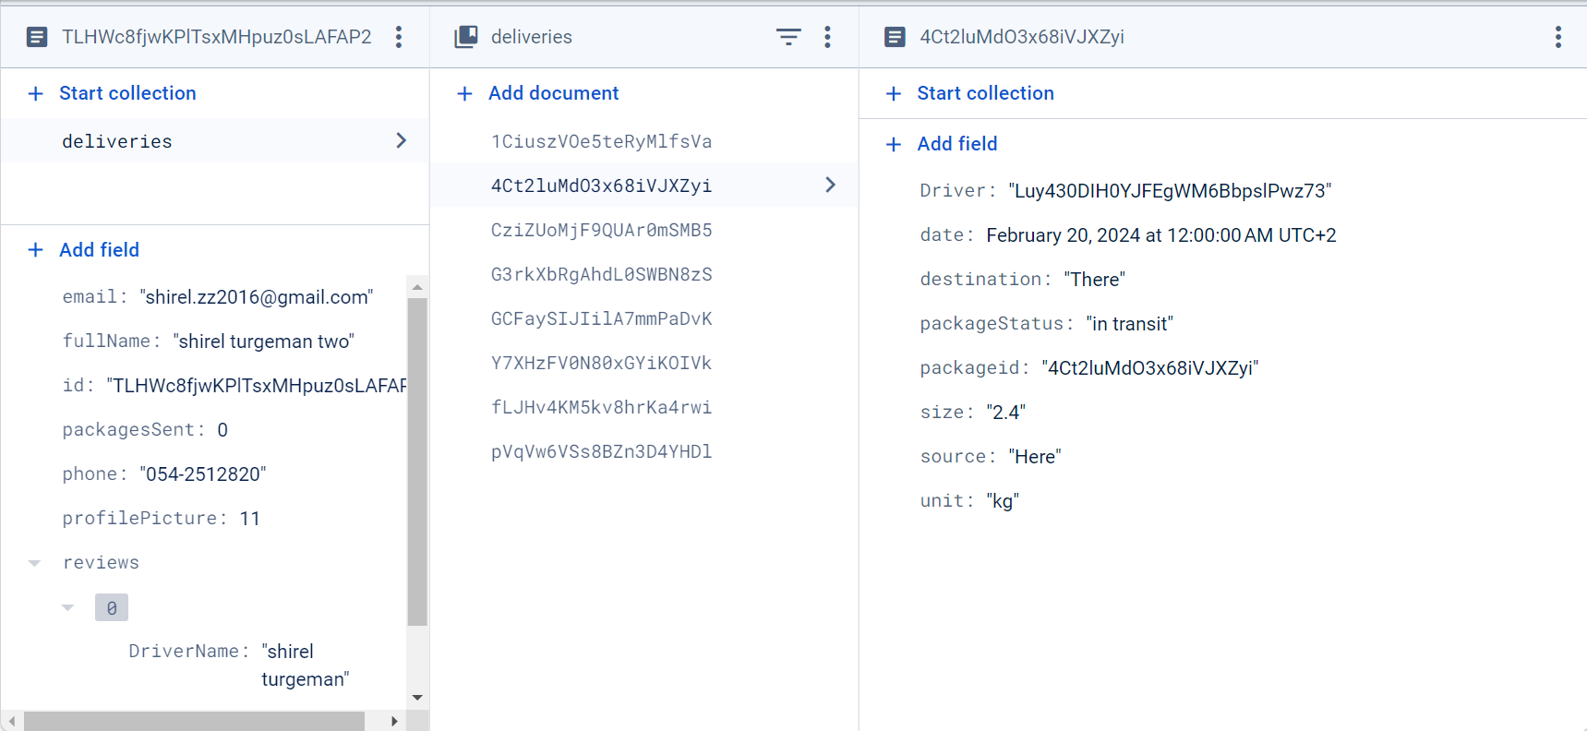
DATABASE - USERS (CLIENT) - DELIVERIES

Slide 22
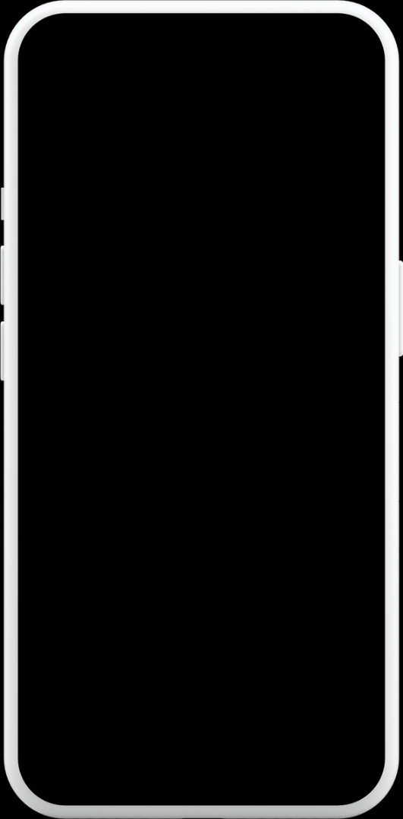
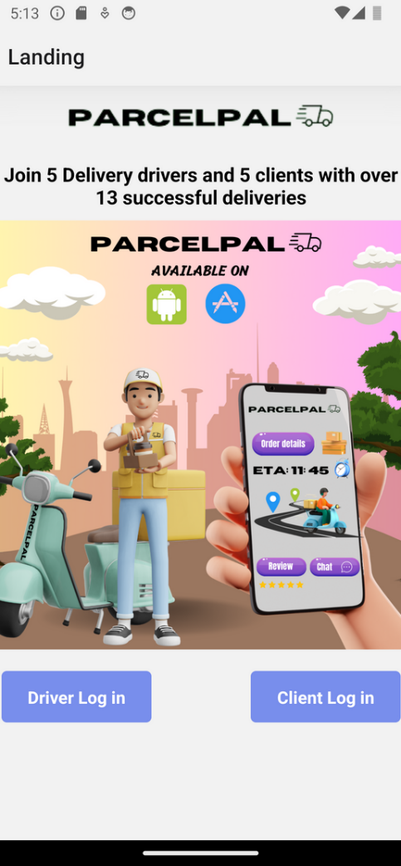
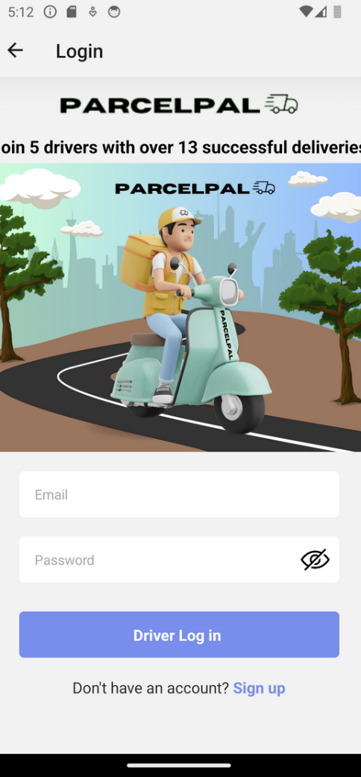
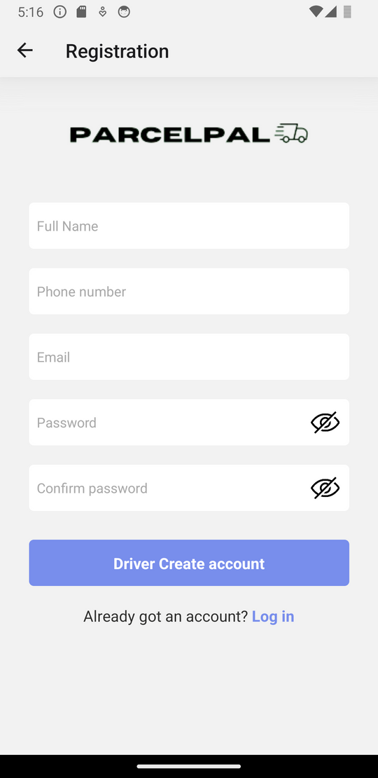
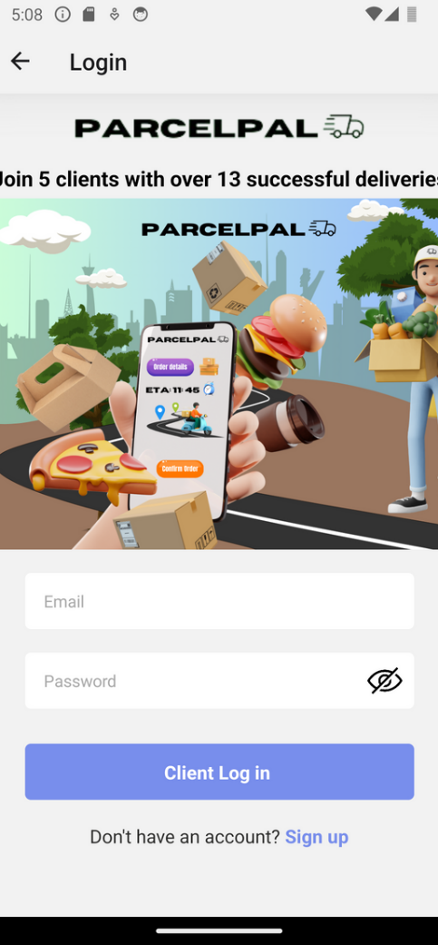

APPLICATION DISCRIPTION:
LOGIN / SIGNUP

Slide 23
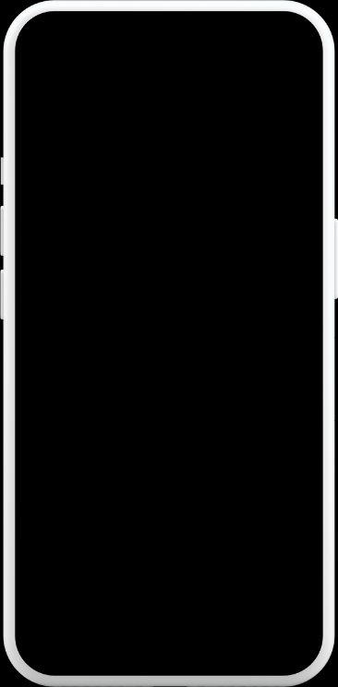



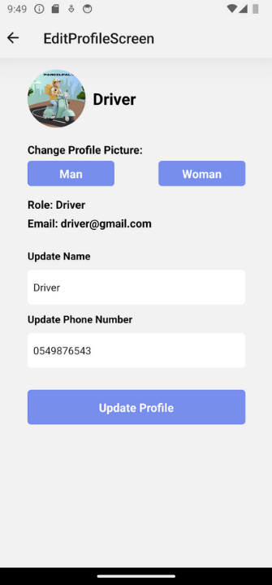
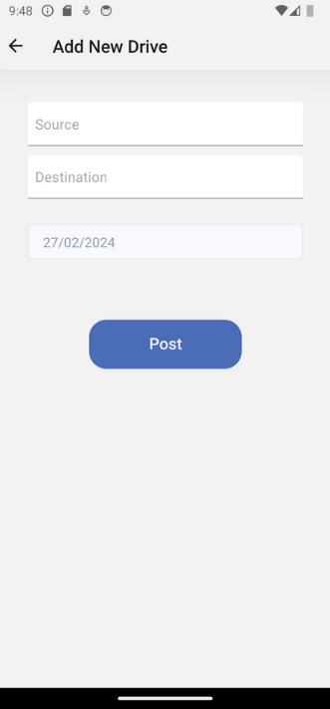
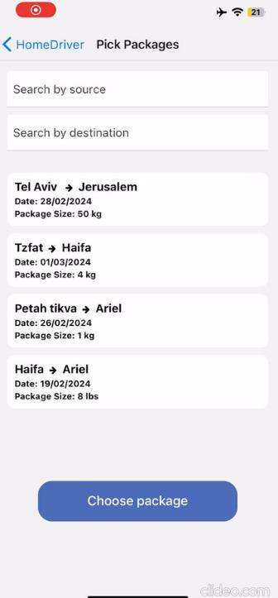
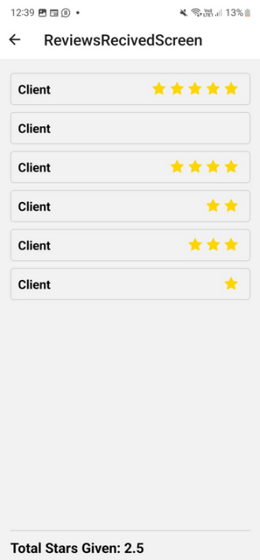


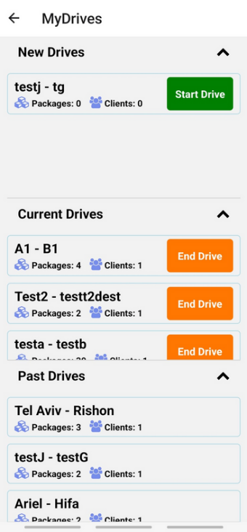
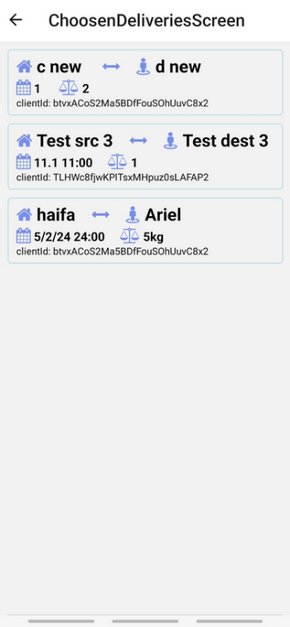
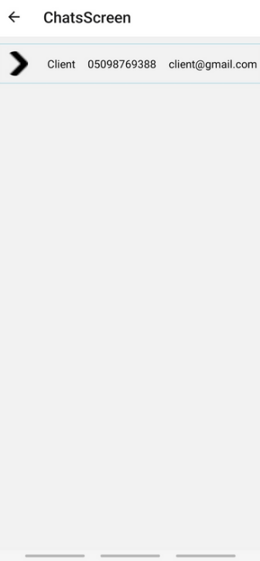
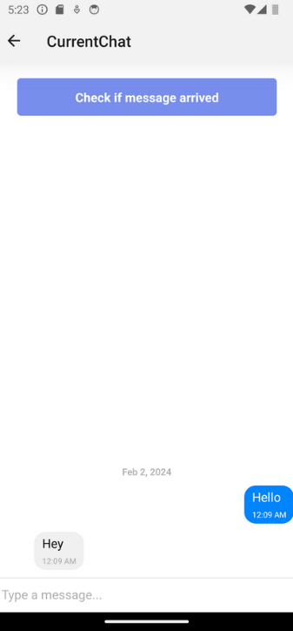
DRIVER
APPLICATION DISCRIPTION:

Slide 24

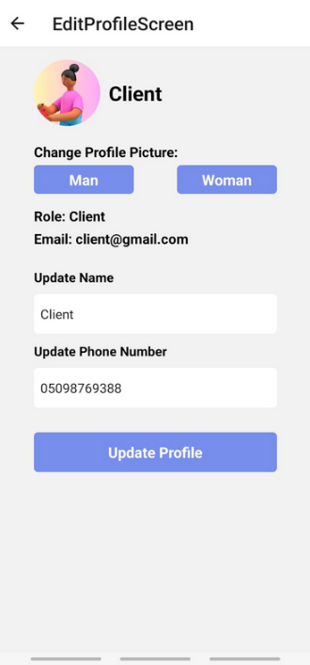
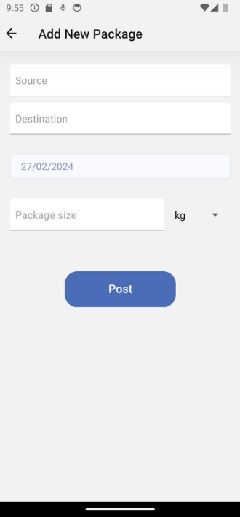
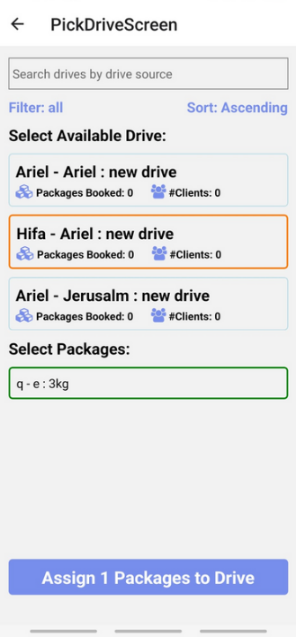





CLIENT
APPLICATION DISCRIPTION:

Slide 25

SPECIFYING GAPS
In the requirements document, we did not have time to do the following sections
In addition, we did not have time to change the application to MVC
Also, we wanted to add the option to send a gift to the driver through BuyMe but did not have time.

Slide 26

Thank U For Listening

